Slide 1
Opening the Black Box
Mechanistic Interpretability for AI Agent Tool Selection Using Sparse Autoencoders
Hannes Hapke with David Cardozo
575 Lab, Dataiku Inc.
1

Slide 2
Work in Progress
These slides are a preview. The ﬁnal version will include:
Live demo of Kiji Inspector integrated with Databricks Agent Bricks
Broader model support -- extending the framework to Llama and Qwen
Larger-scale SAE companions -- training SAEs for larger open-source models, where we expect stronger
causal signal
2

Slide 3
The Problem: Opaque Agent Decisions
AI agents autonomously select tools (databases, web search, code execution, ...) based on natural language
requests -- but why?
"Find information about our company's API rate limits."
→
Internal docs search? Or public web search?
Current approaches fail to provide mechanistic insight:
1. Prompt engineering -- reveals correlations, not causal mechanisms
2. Behavioral testing -- characterizes inputs/outputs, not internals
3. Chain-of-thought -- plausible narratives
true computation
We need to look inside the model.
3

Slide 4
Our Contribution
A complete, open-source pipeline for agent explainability:
1. SAE training workﬂow -- train sparse autoencoders to decompose agentic tool-selection decisions into
interpretable features
2. Contrastive dataset generation -- synthesize semantically similar prompt pairs that isolate subtle
diﬀerences driving tool choice
3. Model-agnostic framework -- applicable to any open-source LLM; demonstrated on NVIDIA Nemotron-3
Nano/Super
Production-ready tooling -- fully open source:
SAE training framework | vLLM patch for activation extraction | SAE inference server
GitHub: github.com/dataiku/kiji-inspector
4

Slide 5
What's Novel?
1. Decision token extraction -- capture activations at the precise moment of tool commitment
2. Contrastive pairs as post-hoc probes -- SAE learns the model's natural vocabulary unsupervised;
contrastive pairs are statistical probes only
3. Token-level fuzzing evaluation -- adapted from Eleuther AI's autointerp; catches labels that are "right for
the wrong reasons"
4. Causal validation via feature ablation -- zeroing features and measuring prediction ﬂips
5

Slide 6
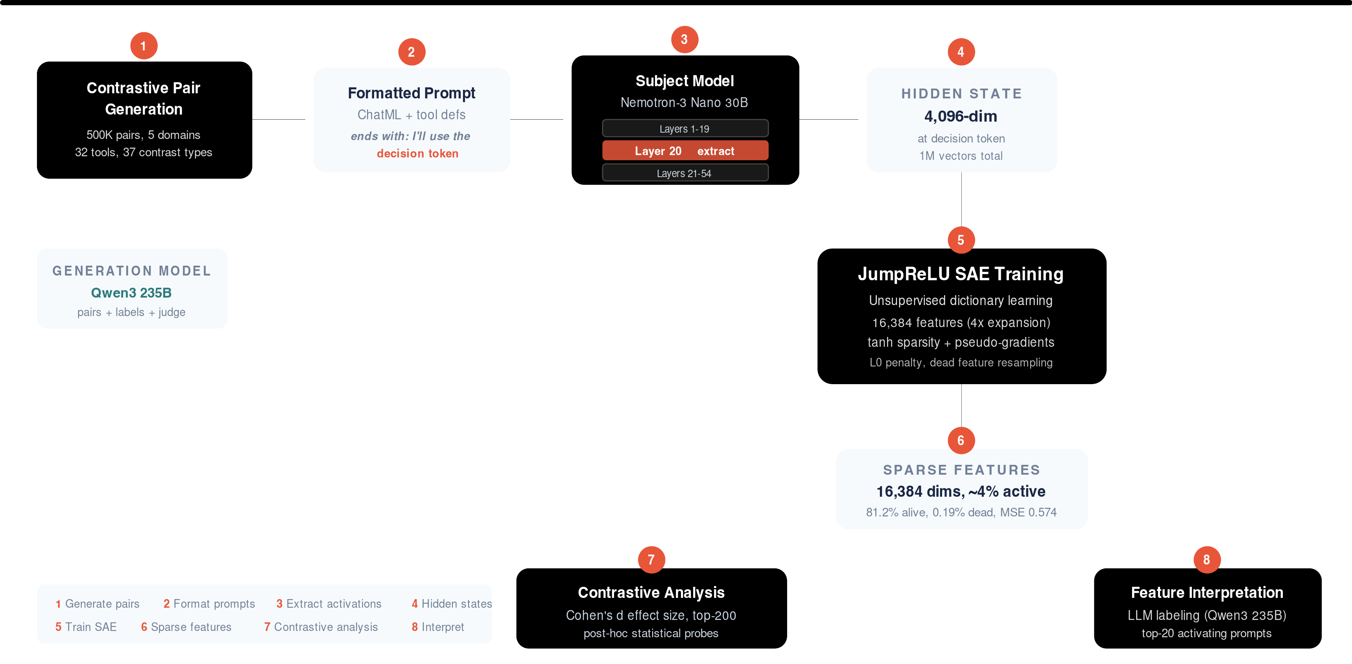
Our Complete Training Pipeline
Contrastive pairs are generated and encoded by the subject model. The SAE is trained unsupervised on the
extracted activations; contrastive pairs serve only as post-hoc statistical probes.
6

Slide 7
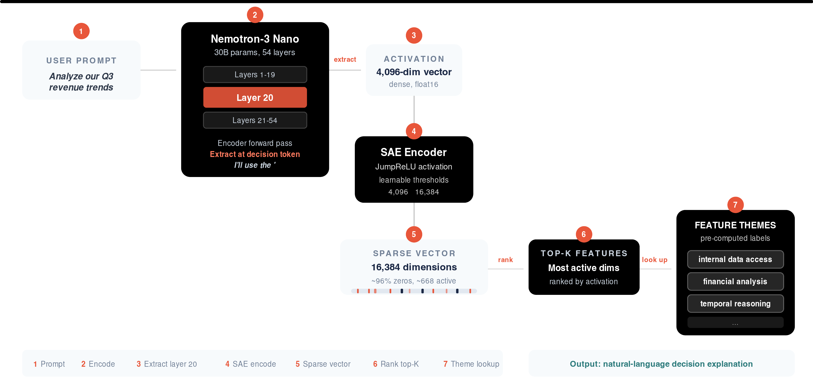
Our Inference Setup
Seven steps from raw prompts to human-readable decision explanations.
7

Slide 8
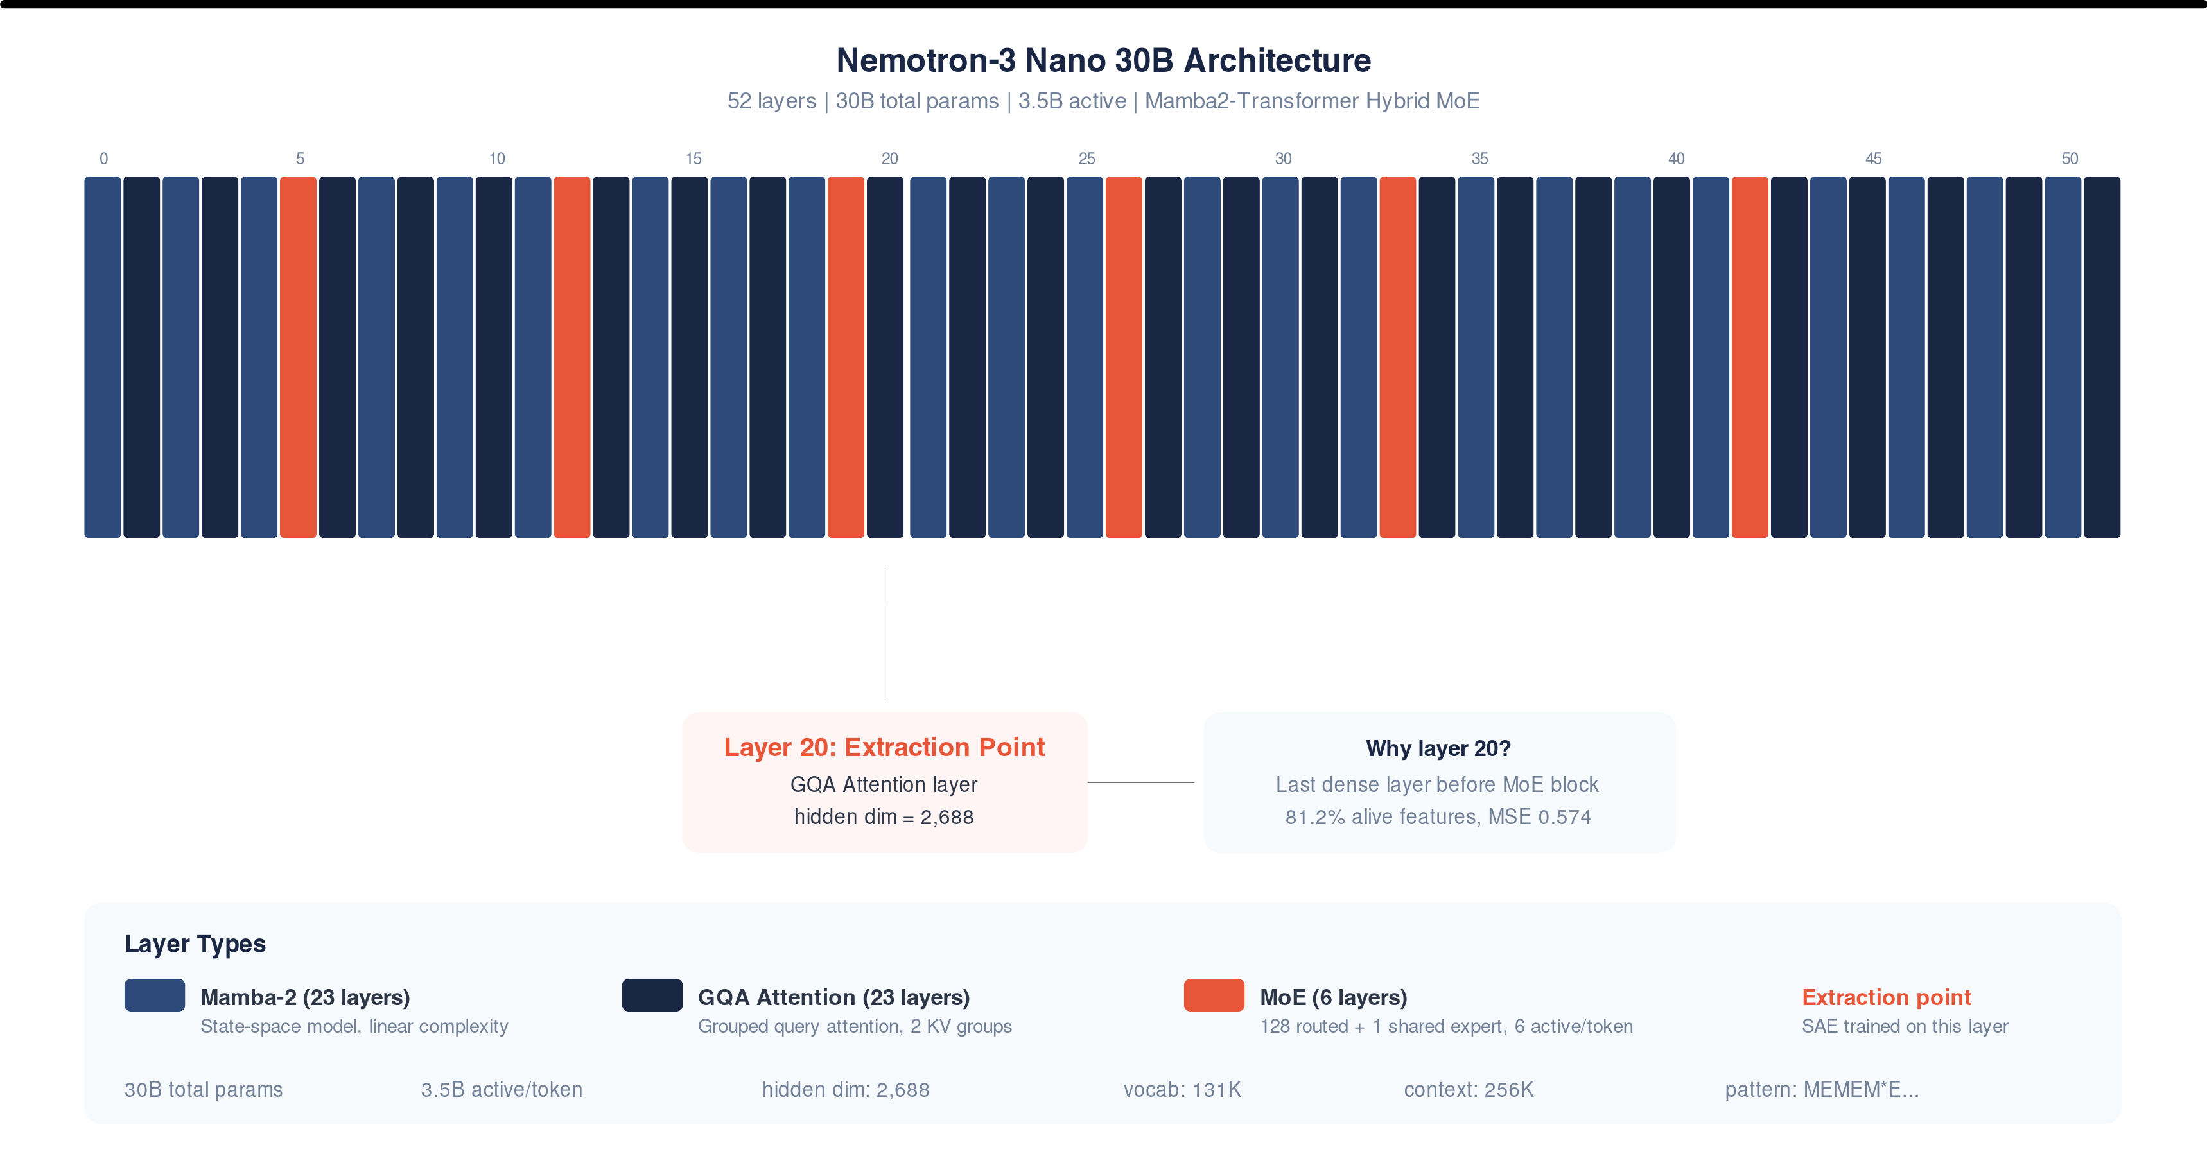
Nemotron-3 Nano Architecture
Hybrid Mamba2-Transformer MoE with 52 layers. We extract activations at layer 20 (GQA Attention), the last
dense layer before the next MoE block.
8

Slide 9
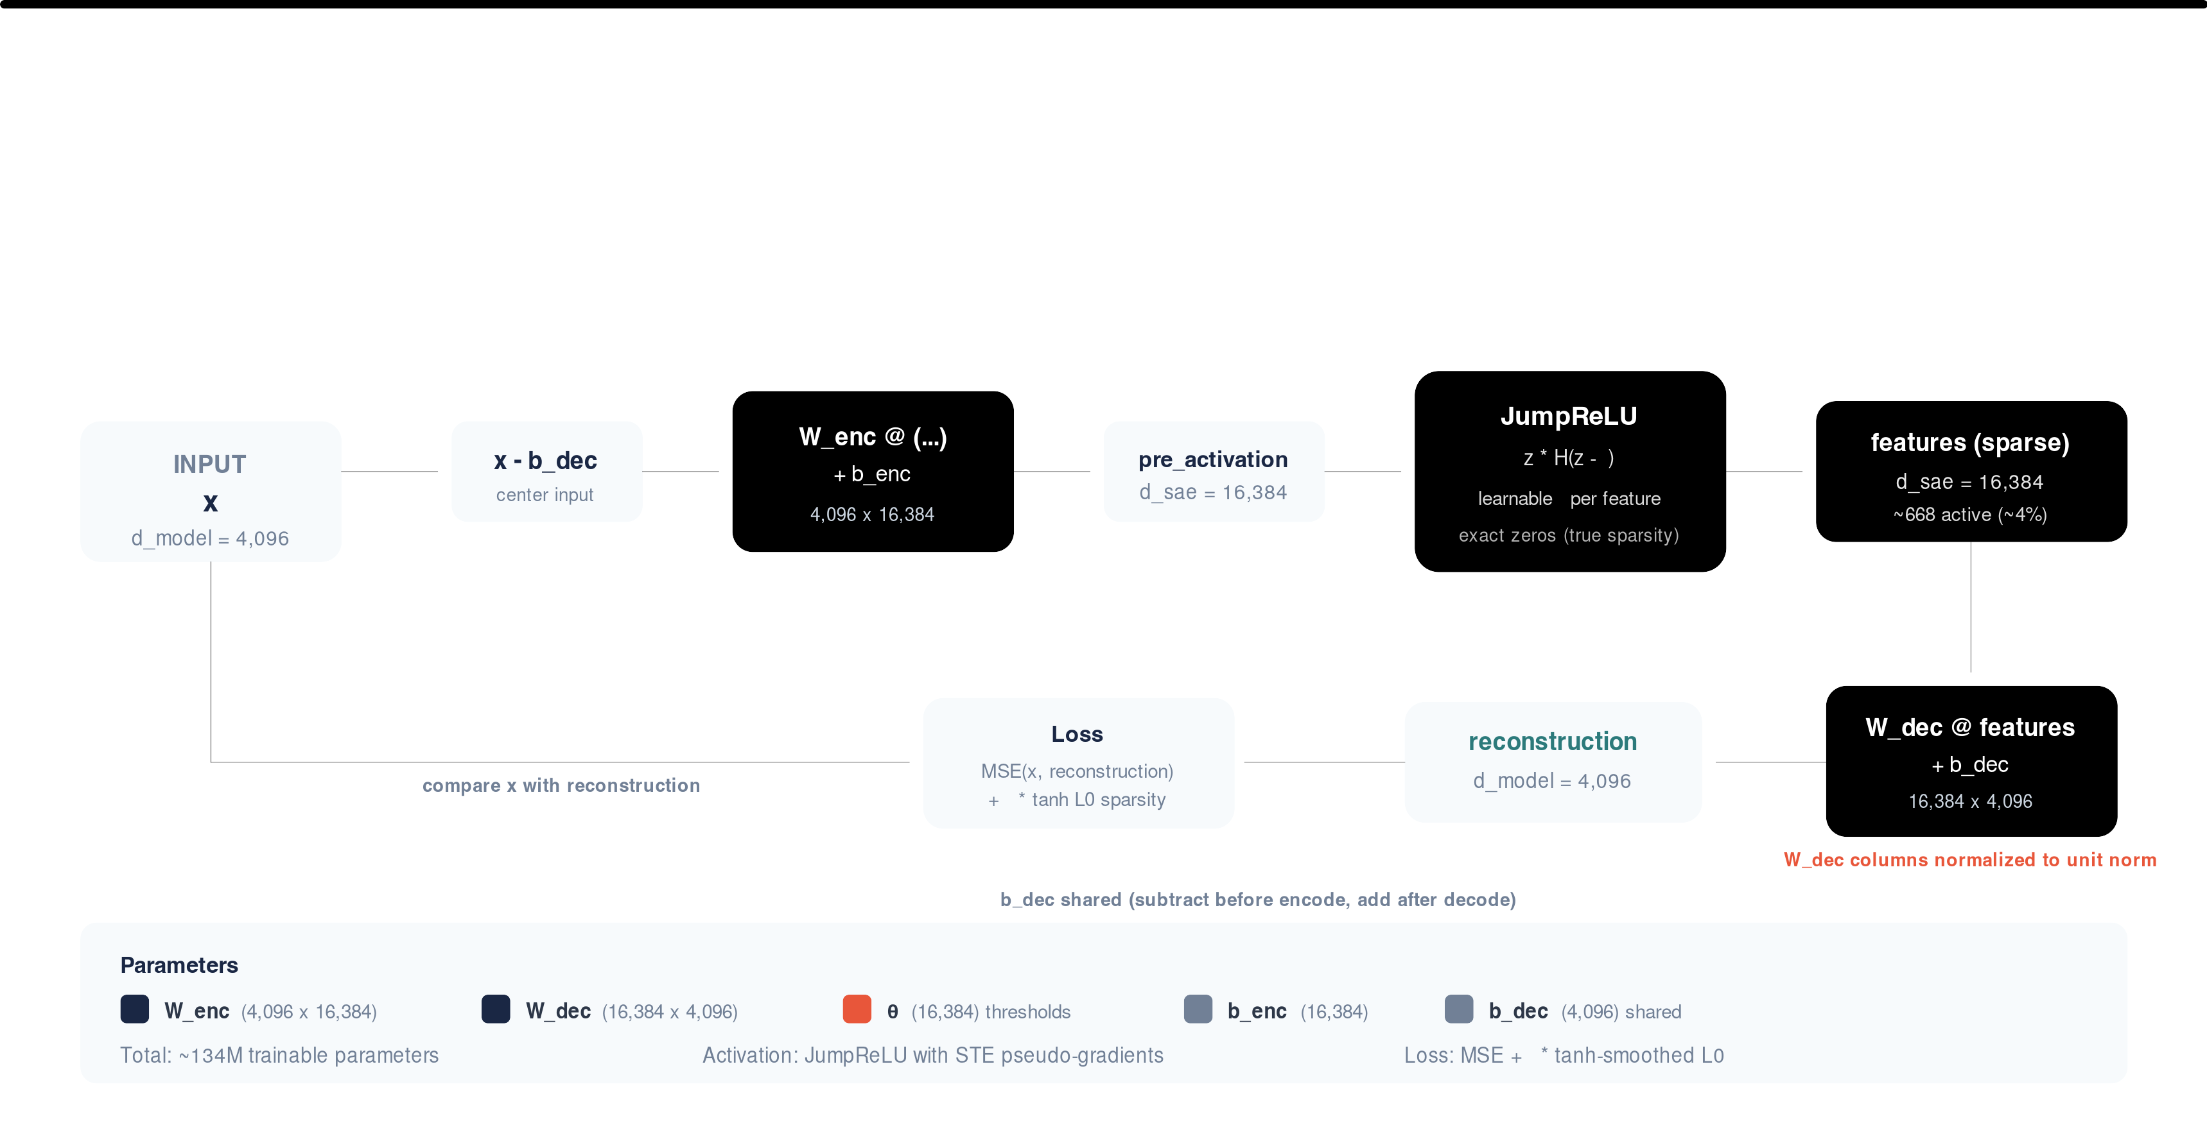
PyTorch SAE Model Architecture
Encoder projects 4,096-dim input to 16,384 sparse features via JumpReLU with learnable per-feature thresholds.
Decoder reconstructs with unit-norm columns. Shared bias b_dec centers the input.
9

Slide 10
Decision Token Extraction
Every formatted prompt ends with:
<|assistant|> I'll use the '
The hidden state at this ﬁnal token is the decision token -- the model's internal state at the moment it commits
to a tool name.
Activations extracted at layer 20 of Nemotron-3-Nano-30B (54-layer MoE)
Hidden dimension: 4,096
Batched extraction with left-padding for alignment
Dataset: 1,000,000 activation vectors (500K contrastive pairs)
10

Slide 11
Contrastive Pair Design
Pairs share the same intent but require diﬀerent tools:
Shared Intent
Anchor (tool A)
Contrast (tool B)
Resolve password
"How do I reset my password?"
→
"I tried resetting 3 times but the email never arrives"
→
issue
knowledge_base
ticket_lookup
Evaluate energy
"Which companies invest in renewables?"
→
"Which stocks trade below book value?"
→
stocks
financial_analysis
market_data_lookup
Check product
"What is the latest version?"
"Set the version to v3.2.1"
version
→
file_read
→
file_write
5 domains, 32 tools, 37 contrast types.
11

Slide 12
JumpReLU SAE Architecture
Encoder:
where
and
is a learnable threshold.
Key properties:
Exact sparsity -- Heaviside step function
produces true zeros
Smooth training -- tanh approximation for gradient ﬂow:
Pseudo-gradients via rectangular kernel density estimator
Dictionary size
(
hidden dim).
12

Slide 13
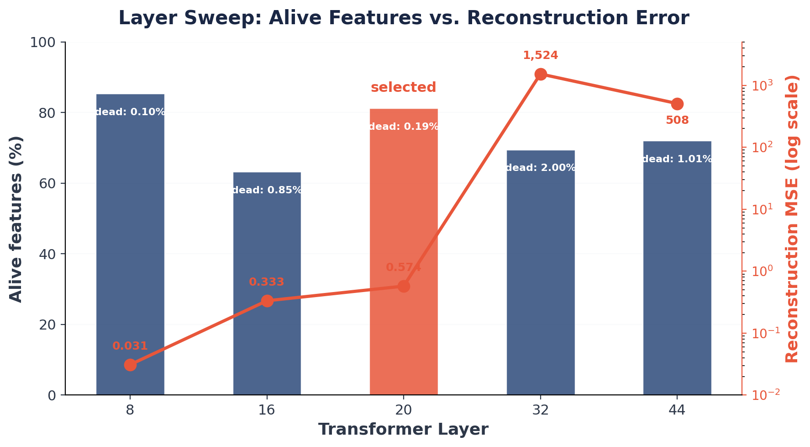
Why Layer 20?
Layers 8/16: low MSE but pre-decision representations
Layer 20: best alive %, lowest dead %, MSE < 1.0
Layers 32+: MoE expert routing
→
500x+ higher MSE
13

Slide 14
SAE Feature Health (Layer 20, Full Dataset)
Metric
Value
Total features
16,384
Alive features (>0.1% ﬁring)
81.2% [80.6, 81.8]
Dead features (0% ﬁring)
0.19% [0.13, 0.27]
L0 (active features per input)
668 (≈4.1% density)
Reconstruction MSE
0.574
The SAE eﬃciently uses its capacity: sparse encoding with high feature utilization.
14

Slide 15
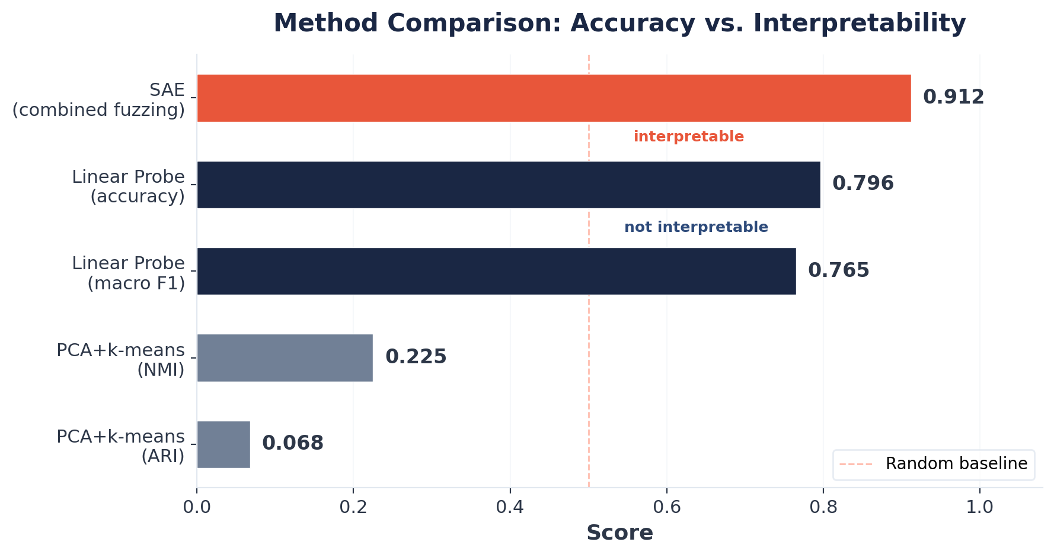
Baselines: Why Not Just a Probe?
Linear probe conﬁrms tool identity is linearly encoded (79.6% across 32 classes) -- but provides no
interpretability
PCA + k-means fails entirely -- tool signal is not dominant variance
The SAE bridges this gap: interpretable and causally testable features
15

Slide 16
Token-Level Fuzzing Evaluation
Standard evaluation: "Does this label predict which prompts activate the feature?"
Our evaluation: "Does this label predict which tokens activate the feature?"
Protocol:
1. Extract per-token activations across entire prompt
2. Highlight top-K tokens in user request span
3. A/B test: LLM judge picks which highlighted text matches the label
4. Randomized order to prevent position bias
Combined score =
Token-level gets higher weight because it tests the actual mechanism.
16

Slide 17
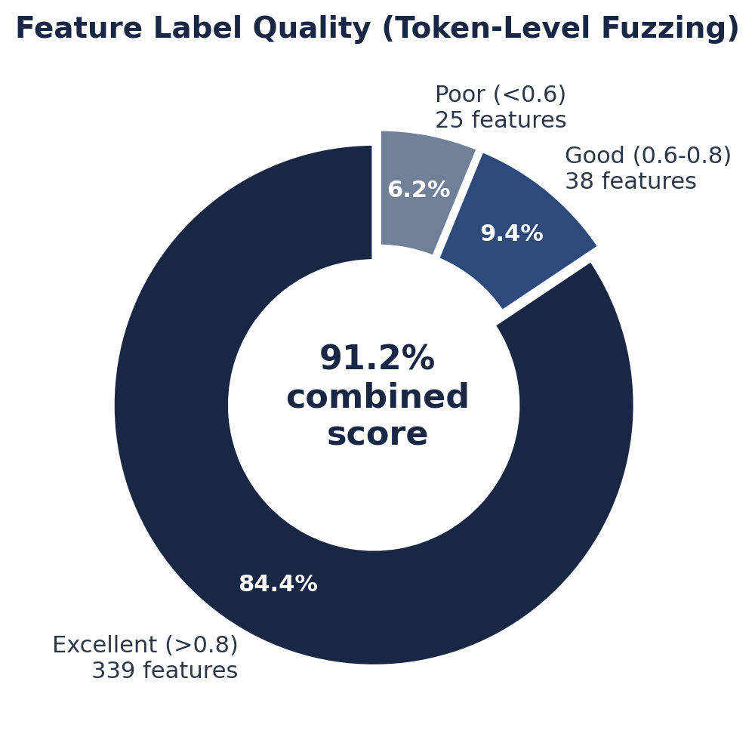
Fuzzing Results: Features Are Interpretable
402 features, combined score 0.912 ± 0.008 (p < 10^-4)
Token-level accuracy: 0.906 ± 0.007
Emergent features without supervision: "internal knowledge retrieval",
"data modiﬁcation intent", "query complexity"
17

Slide 18
The Causality Test
From Correlation to Causal Evidence
18

Slide 19
Feature Ablation: Experimental Design
Question: Are contrastive features causally necessary for tool selection, or merely correlated?
Method:
1. Intercept residual stream at layer 20
2. Encode through trained SAE
3. Zero out top-10 contrastive features
4. Decode back into residual stream
5. Measure: does the model's tool prediction ﬂip?
Controls:
Random ablation: zero 10 random non-contrastive features
Reconstruction-only: SAE encode
→
decode with no features zeroed (measures round-trip distortion)
19

Slide 20
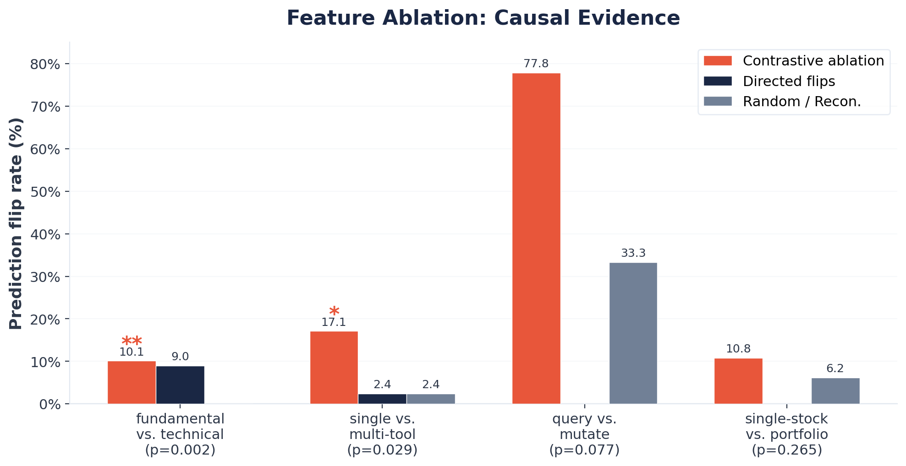
Ablation Results: Causal Evidence
Aggregate (23 types): 16.1% contrastive vs. 13.0% reconstruction-only
20

Slide 21
Why This Matters: Interpreting the Ablation
Fundamental vs. Technical Analysis (p = 0.002):
Zeroing 10 contrastive features ﬂips 10.1% of predictions
9.0% ﬂip toward the contrast tool (directed change)
Random ablation: 0% ﬂips. Reconstruction-only: 0% ﬂips
These features are causally necessary for this distinction
Critical control insight:
Random ablation ﬂip rate equals SAE round-trip distortion across all 23 contrast types. Removing 10 random features
from ~668 active adds no disruption beyond the encode-decode cycle itself.
This validates the design: ablation eﬀects are due to speciﬁc features, not general signal degradation.
21

Slide 22
The Spectrum of Causal Involvement
Not all decisions rely on sparse feature circuits:
Sparse circuits (2/23 types signiﬁcant): fundamental/technical, single/multi-tool -- concentrated in
identiﬁable features
Distributed representations (9/23 types, 0% ﬂips): preventive/reactive maintenance, etc. -- robust to
removing any 10 features
This reveals a heterogeneous landscape:
Some tool-selection decisions are governed by interpretable sparse circuits; others rely on distributed, redundant
encodings.
Both ﬁndings are scientiﬁcally valuable.
22

Slide 23
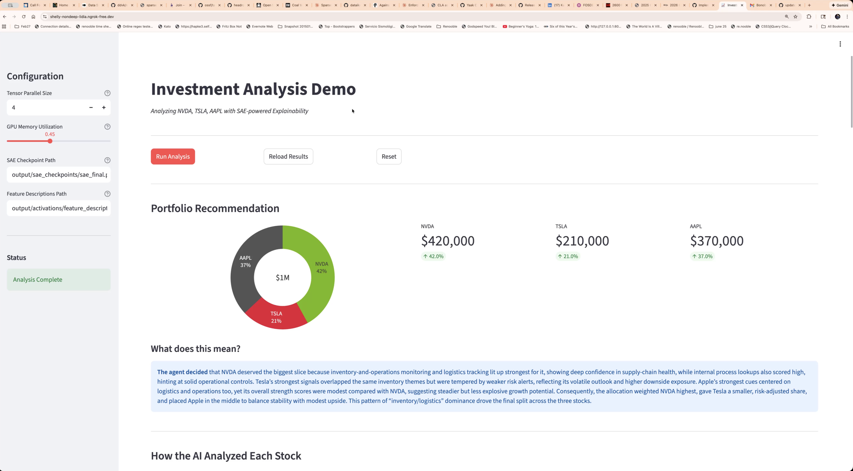
End-to-End Demo Application
Interactive system surfacing SAE-derived explanations alongside agent output -- translating internal feature
activations into natural-language rationales.
23

Slide 24
Key Takeaways
1. SAEs discover interpretable decision features without supervision -- 91.2% fuzzing accuracy, 84.3%
excellent quality
2. Token-level fuzzing catches labels "right for the wrong reasons" -- a stricter test than prompt-level
evaluation
3. Causal evidence via ablation: speciﬁc features are necessary for speciﬁc tool-selection decisions (p =
0.002)
4. The reconstruction-only baseline is essential -- it separates genuine causal eﬀects from SAE distortion
artifacts
5. Heterogeneous decision landscape -- some decisions use sparse circuits, others are distributed
24

Slide 25
Limitations and Future Directions
Current limitations:
Compute-intensive (235B generation model + 30B subject model)
Single-layer analysis (layer 20 only)
Synthetic contrastive pairs may miss real-world decision factors
Optimal ablation set size remains an open question
Future work:
Higher-ﬁdelity SAEs for cleaner causal experiments (Gated SAEs, larger dictionaries)
Multi-layer / circuit-level analysis
Cross-model transfer (do tool-selection circuits generalize?)
Real-time agent monitoring in production
25

Slide 26
Thank You
Open source: github.com/dataiku/kiji-inspector
Hannes Hapke -- hannes.hapke@dataiku.com
David Cardozo -- david.cardozo@dataiku.com
575 Lab, Dataiku Inc.
26

